Slide 1
Object Detection On Indianapolis Racing Car Images: Using Retinanet
Manjulata Garimella

Slide 2
Goal/Objectives
The goal of my project is to explore the performance of object detection models specifically RetinaNet on object detection of cars and smoke by using the Indianapolis car racing images.
Objectives
Build dataset with annotations for Smoke Images – 200 images were annotated with smoke
Pre-processing/Data Augmentation – normalized images, clipped images 1-0, resized image (224,224)
Building a model – RetinaNet model with Resnet50, Resnet152 as backbone network
Evaluation of model on unseen images – computed mAP score and visualization result

Slide 3
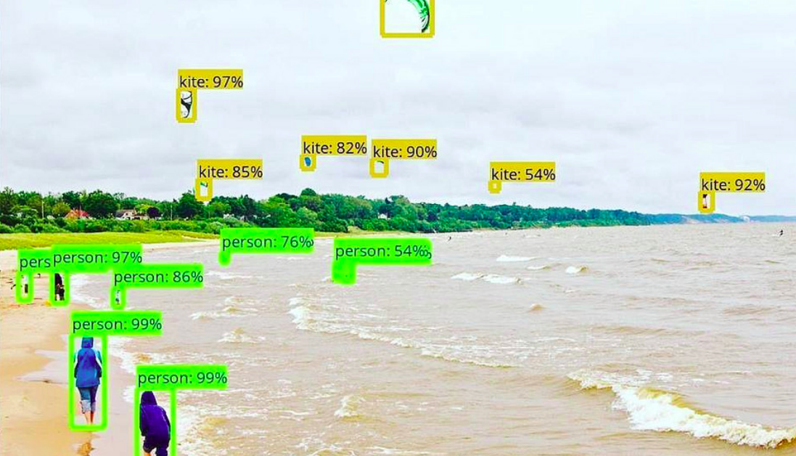
BackGround
Object detection: The goal of object detection is finding all objects in the image (object localization), identifying category (i.e. object classification), and drawing so-called bounding boxes around them.
Object detection task has several computer vision applications including motion detection, image classification, bio-metrics, self driving cars, robotics etc.,

Slide 4
BackGROUND
One stage object detection models - One stage models work on the whole image as opposed to selecting interesting parts of the image.
Two stage object detection models - these models work in two stages, in the first stage, the model extracts interesting regions from the image and, in the next stage, runs prediction on every selected region. Most common example of these models is Region-based convolutional neural network (RCNN) and its cousins Fast-RCNN and Faster-RCNN.

Slide 5
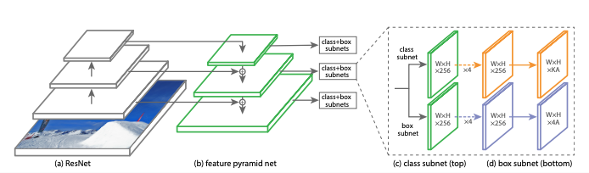
RetinaNet - One stage object detector
RetinaNet has been formed by making two improvements over existing single stage object detection models (like YOLO and SSD):
Focal Loss: Focal Loss is an improvement on cross-entropy loss helps to reduce the relative loss for well-classified examples and putting more focus on hard, misclassified examples.
Feature Pyramid Network (FPN): Pyramid networks have been used conventionally to identify objects at different scales. A Feature Pyramid Network (FPN) makes use of the inherent multi-scale pyramidal hierarchy of deep CNNs to create feature pyramids.

Slide 6
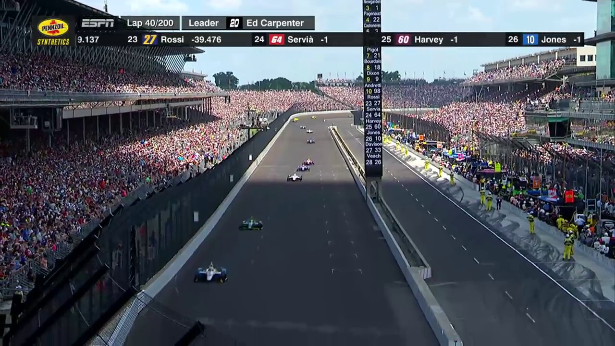
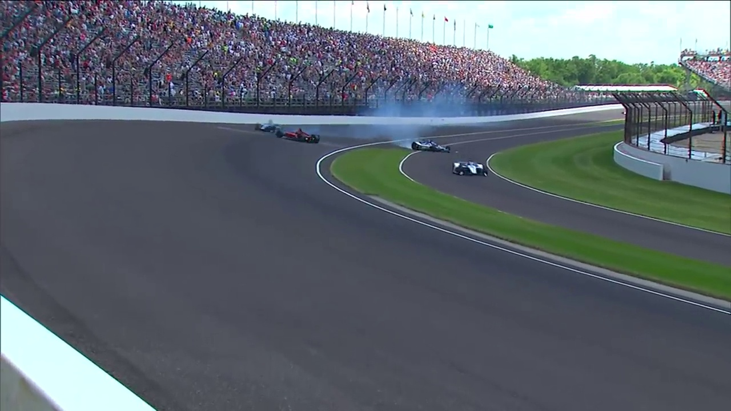
Implementation Details
Training Set – 2910 images of which 200 images were annotated for smoke
Test Set – 186 images

Slide 7
Implementation Details
Model Parallelization – NVIDIA GPUs K80 were used
Two variants of RetinaNet were considered:
Model 1 – Resnet50 backbone network, Adam optimizer, learning rate 1e-5
Model 2 – Resnet152 backbone network, Adam optimizer, learning rate 1e-3

Slide 8
Experiments and Results
Model 1 – Resnet50 model as the backbone network
Resnet-50 as feature extractor - that is pretrained on ImageNet. Adam optimizer was used with learning rate of 1e-5.

Slide 9
Experiments and Results
Model 2 - Resnet-152 as feature extractor - that is pretrained on ImageNet. Adam optimizer was used with learning rate of 1e-3.

Slide 10
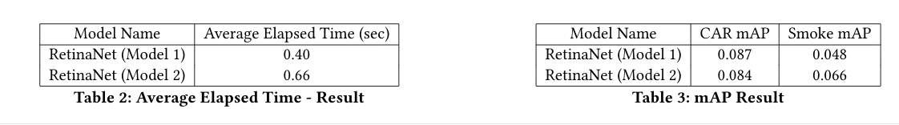
Experiments and Results

Slide 11
Experiments and Results

Slide 12
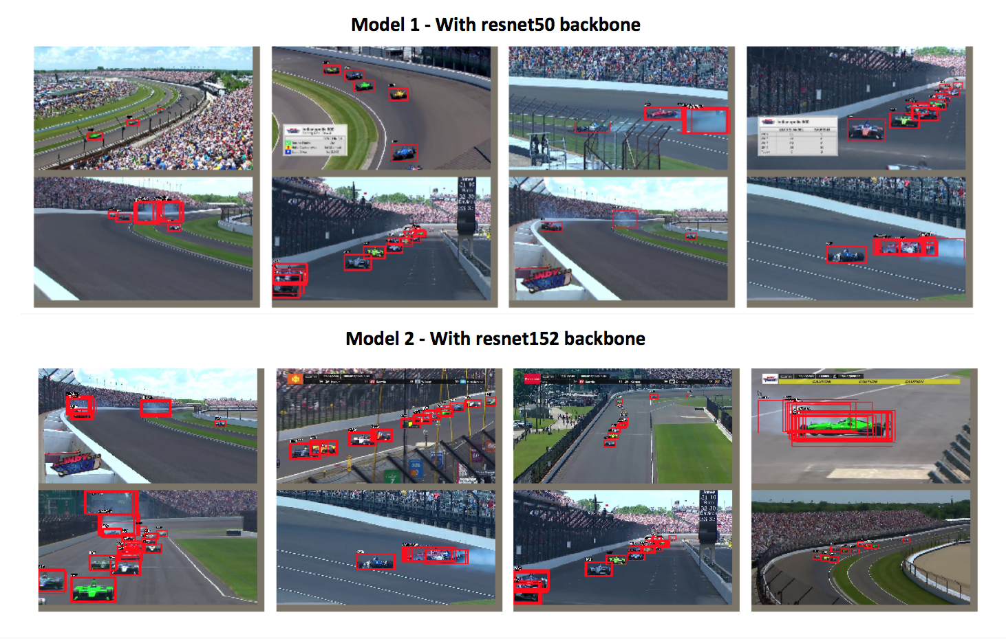
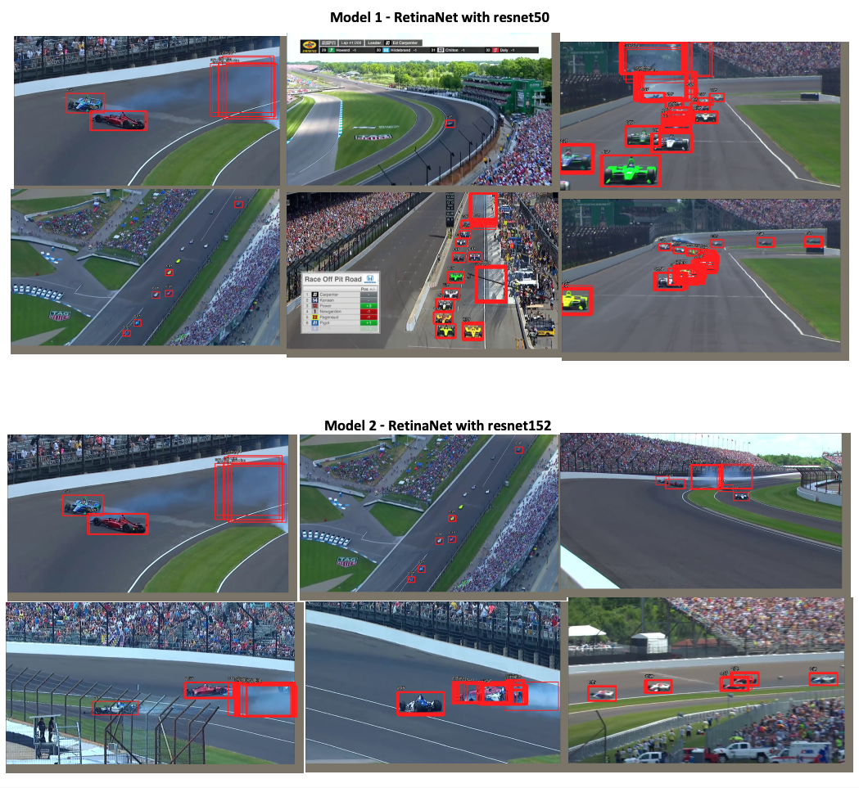
Experiments and Results

Slide 13
Conclusion/FUTure work
Current approach for object detection using RetinaNet in its two variants can be considered as a baseline result especially for smoke detection.
The approach is simple and easy to train and has fast inference times.
Future work:
Training data related to smoke images could be increased either with annotating more images or with the use of data augmentation techniques.
This will provide more training data and help train the model with large dataset and in turn results in larger mAP value

Slide 14
Thank you

